Slide 1
Introduction to Graphics Programming and its Applications
繪圖程式設計與應用
Practice
Instructor: Hung-Kuo Chu
Department of Computer Science
National Tsing Hua University
CS4505

Slide 2
Practice
Add new custom event
Control display loop

Slide 3
Practice 1
Add new custom event

Slide 4
Objective
Add new mouse event with GLUT
Output cursor coordinate when hit left button
Output cursor coordinate when release left button
Add some new option in button list
At least 2 new options
You can do whatever you want in these new features

Slide 5
Hint
Window-Specific Callback Registration Functions
Commonly used call back function :
glutMouseFunc
glutMouseWheelFunc
glutKeyboardFunc
glutSpecialFunc
Register events before entering main loop

Slide 6
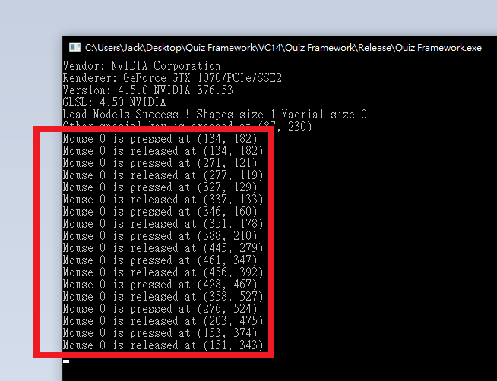
Example

Slide 7
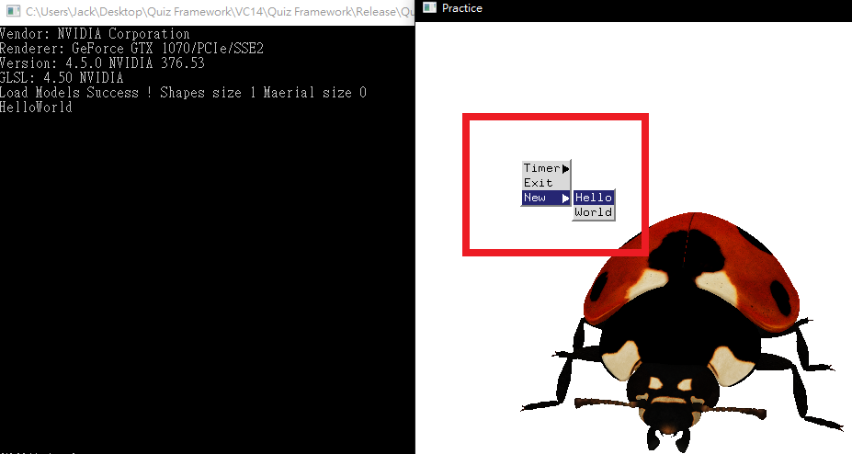
Example

Slide 8
Practice 2
Control display loop

Slide 9
Objective
Translate the model with keyboard
Either any direction or value is fine, but the model should stay visible for TAs to check
Any keyboard Input is allowed
Rotate the model according to the elapsed time
Either any speed or direction is allowed, but the model should rotate upon itself but NOT rotate around original axis.

Slide 10
Hint
Use glutGet(GLUT_ELAPSED_TIME) to get the value of time
The predefined variable ‘model’ is a matrix which represents model’s transform matrix
Apply some matrix operation to the variable ‘model’ to achieve the goal
Check GLM transform API
glm::translate
glm::rotate
Be careful of the operation order ( first translate then rotate != first rotate then translate )

Slide 11
Hint
The vertices information are already in the buffer, so all we need to do is try applying the transform matrix to these points.
Transfer the time value as a parameter to glm::rotate to make the model spin according to time

Slide 12
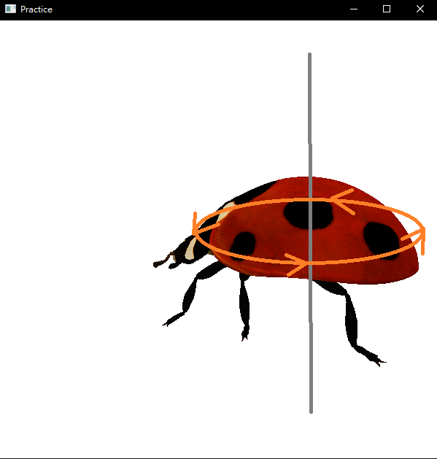
Example

